Slide 1

May 27, 2021
Technical Solutions to Evaluation Fairness in Algorithms
Team 7: Kristy Guo, Barbara Liang, Jingjing Lu, Chiebuka Onwuzurike, Qiqi Tang

Slide 2



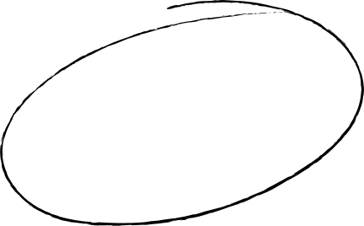

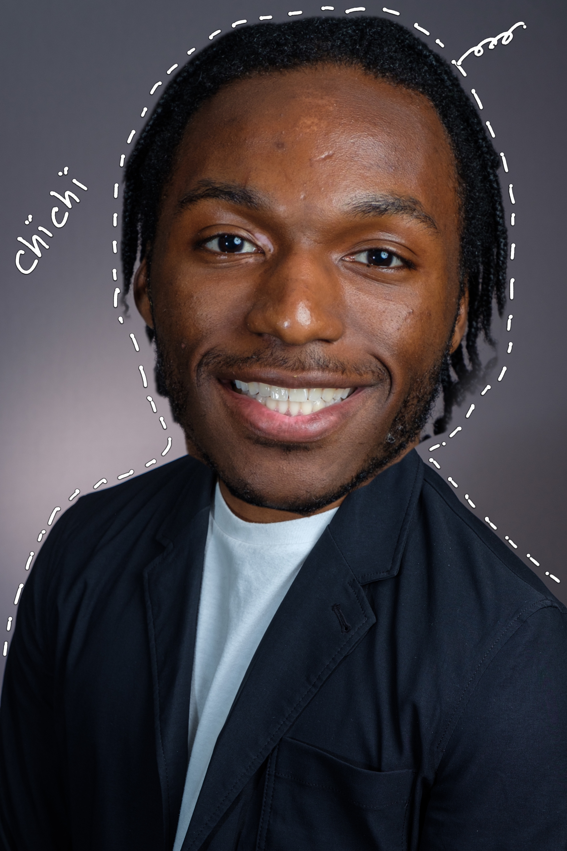
Team
cc
kk
bb
kiki
chichi

Slide 3
Introduction
53%
“only 53% of organizations have a leader who is responsible for the ethics of AI systems”
52%
“majority of consumers are more frightened (52%) about the future impact of AI on society than excited”
Create a safe environment for users
Increase acceptance

Slide 4
Is it ethical to use algorithms to predict crimes?
Are you ready?

Slide 5

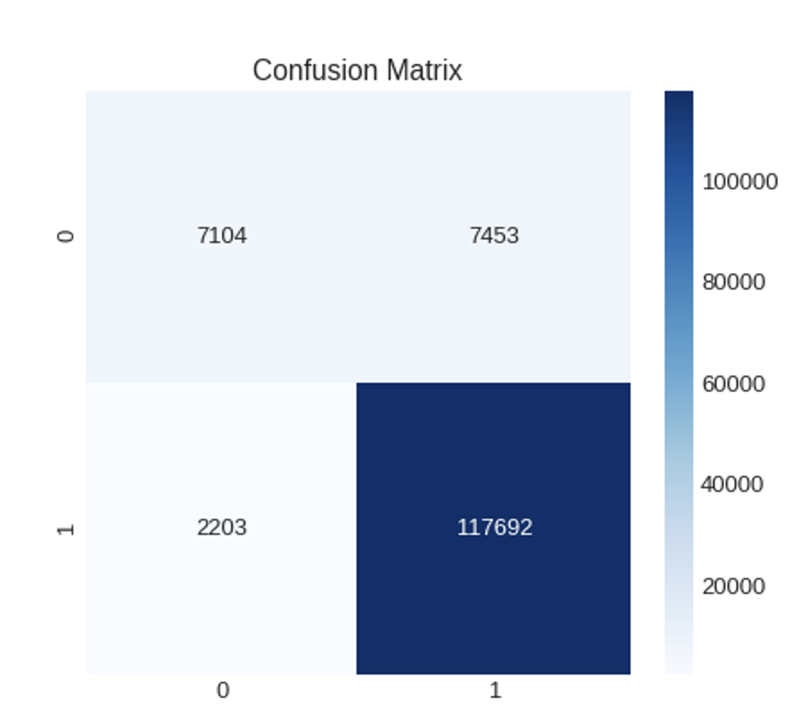
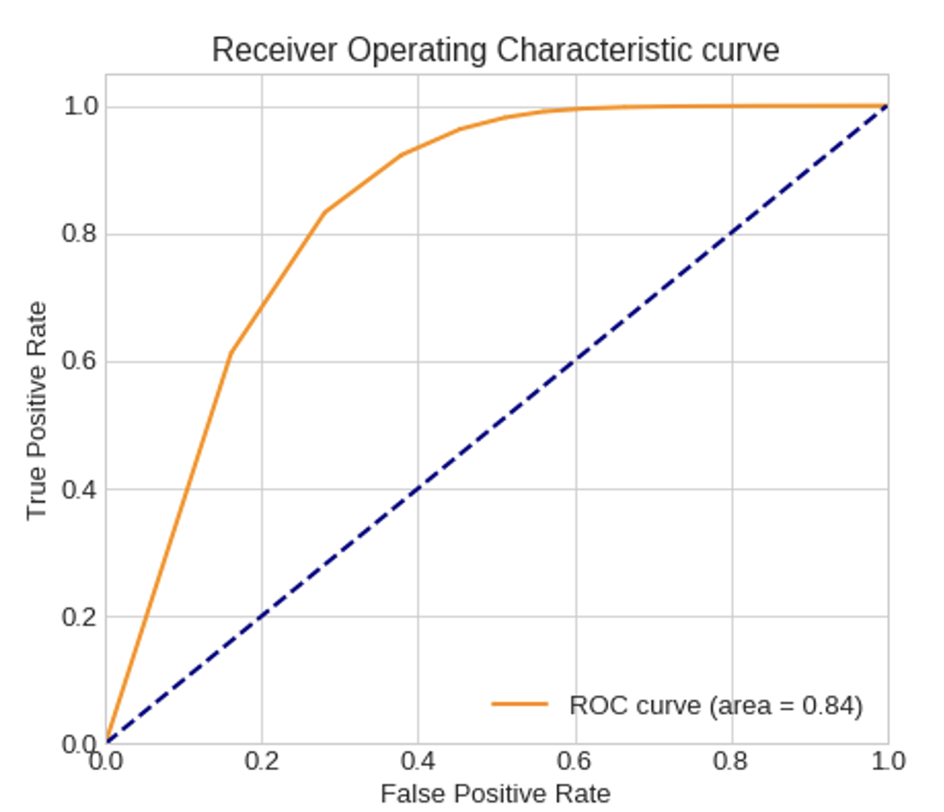
Accuracy: 92.81%
Case
Between 1980 -2014 there were 190,282 unsolved crimes
A model that could predict the race and sex of a perpetrator based on the victim description and case facts would be extremely useful
Given the purpose of the model it is import the model is accurate and unbiased
F1 Score: 96.05%
Variables
'Agency Name', 'Agency Type', 'City', 'State', 'Year', 'Month', 'Crime Type', 'Victim Sex', 'Victim Age', 'Victim Race', 'Victim Ethnicity', 'Relationship', 'Weapon', 'Victim Count', 'Perpetrator Count', 'Record Source'

Slide 6
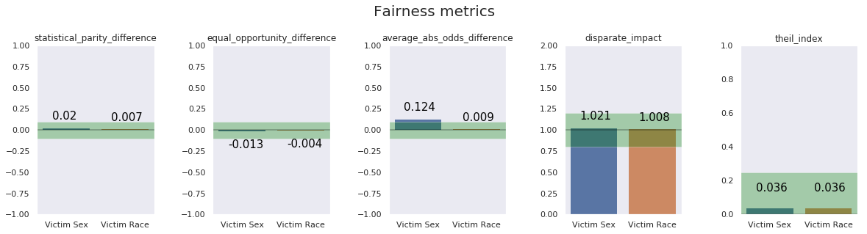
Is the model Unbiased (Fair)?

Slide 7
Confusion Matrix
 | Predicted: positive (privileged) | Predicted: negative (unprivileged)
Actual: positive (privileged) | True Positive (TPR privileged) | False Negative (FPR privileged)
Actual: negative (unprivileged) | False Positive (FPR unprivileged) | True Negative (TPR unprivileged)

Slide 8

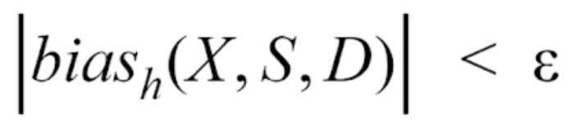
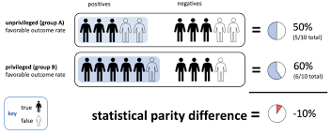
Statistical Parity Difference
Method 1
Statistical Parity Difference suggest a predictor is unbiased (bias(X,S,D)) or fair if the absolute difference between the prediction (Y) of privileged (D) and unprivileged group is lower than a certain threshold (ε)
Is a good metric when statistical power is large and when there aren’t that many underlying cofounders

Slide 9
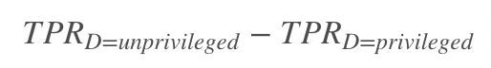
 | Predicted: positive (privileged) | Predicted: negative (unprivileged)
Actual: positive (privileged) | True Positive (TPR privileged) | False Negative (FPR privileged)
Actual: negative (unprivileged) | False Positive (FPR unprivileged) | True Negative (TPR unprivileged)
Equal Opportunity Difference
Method 2
Type your thought here.
Situation when it is a good metric
Situation when it is a bad metric
Ideal value: 0
Fairness: between -0.1 and 0.1
EOD < 0
EOD > 0
privileged
unprivileged

Slide 10
Is concerned with the whole confusion matrix.
Average odds difference = 0
No bias
Advantages : comprehensive
Disadvantages : cumbersome
Average Absolute Odds Difference
Method 3
 | Predicted: positive (privileged) | Predicted: negative (unprivileged)
Actual: positive (privileged) | True Positive (TPR privileged) | False Negative (FPR privileged)
Actual: negative (unprivileged) | False Positive (FPR unprivileged) | True Negative (TPR unprivileged)

Slide 11
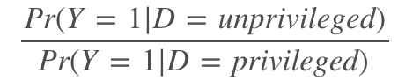
Disparate Impact
Method 4
Formula:
Disparate impact checks discrimination that is unintentional.
Situation when the metric is good:
Employment: reaction test
Possible bias against older applicants (the protected class)
Situation when the metric is bad:
Employment: employers have business reasons to justify reaction test.
Trade-off between costs and fairness

Slide 12
Theil Index
Method 5
The Theil index measures an entropic "distance" the population is away from the "ideal" egalitarian state of everyone having some defined standard.
Value of 0 represents perfect equality
Calculate Theil Index for gender
Widely used to measure economic inequalities
US Census Bureau uses to measure Income inequality

Slide 13

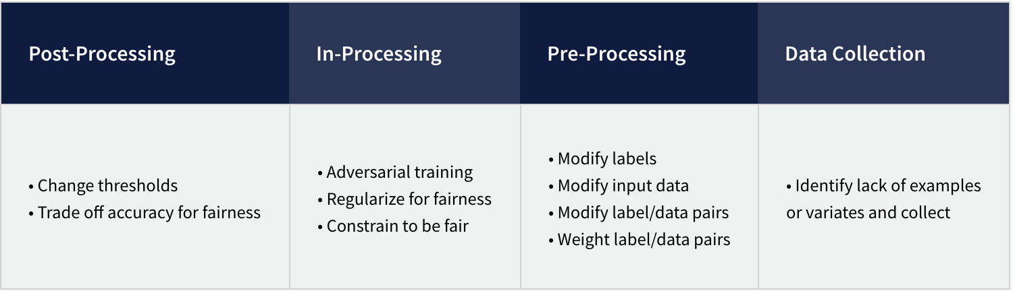
Conclusion
1
How to evaluate if our model/dataset are bias?
Introducing 5 metrics
Could see more standards for fairness
2
How to mitigate bias?

Slide 14
May 27, 2021
Thank you!
Happy
weekend!

